Slide 1
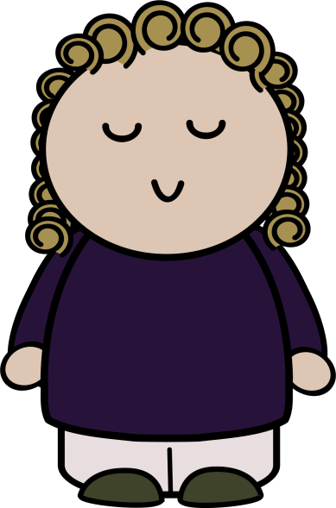
Working with PowerPoint Quiz
Click on the picture of the person to get started

Slide 2
What does slide transition mean?
Click on the answer you think is correct
A.
Slide transition refers to the way we can make a picture move.
B.
Slide transition refers to the way that a slide changes when go on to another slide.
C.
Slide transition involves being able to click on an object and it will take us to a specific slide.

Slide 3
Correct!
Well done! That answer is correct! Click on the home below to take you to the next question

Slide 4
Try again
That’s not quite right. Have another think about your answer and try again. Click the question mark below to go back to the questions and try again.

Slide 5
What does it mean when we animate an object in PowerPoint?
Click on the answer you think is correct
A.
Object animation refers to the way we can make a picture move.
B.
Object animation refers to the way that a slide changes when go on to another slide.
C.
Object animation involves being able to click on an object and it will take us to a specific slide.

Slide 6
Correct!
Well done! That answer is correct! Click on the home below to take you to the next question

Slide 7
Try again
That’s not quite right. Have another think about your answer and try again. Click the question mark below to go back to the questions and try again.

Slide 8
What does it mean to hyperlink a slide?
Click on the answer you think is correct
A.
Hyperlinking refers to the way we can make a picture move.
B.
Hyperlinking refers to the way that a slide changes when go on to another slide.
C.
Hyperlinking involves being able to click on an object and it will take us to a specific slide.

Slide 9
Correct!
Well done! That answer is correct! Click on the home below to take you to the next question

Slide 10
Try again
That’s not quite right. Have another think about your answer and try again. Click the question mark below to go back to the questions and try again.

Slide 11
Well done!
You’ve complete your first quiz. Later on in this lesson, you’ll be making your own quiz like this.

