Slide 1
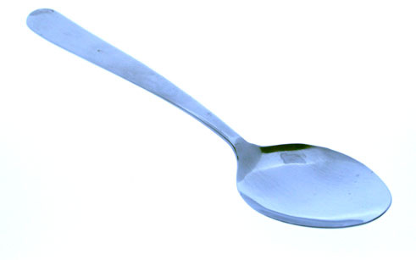
Hyperlink these images to their names on other slides

Slide 2
Fork

Slide 3
KNIFE

Slide 4
SPOON

